Slide 1
REAL TIME TRAFFIC OBJECT DETECTION & DATA ANALYSIS
Presented by : Aakash P
Guided by : Prof. Biju Skaria

Slide 2
CONTENTS
Introduction
Project Division
Objective
Key Functionalities
Technology
Relevance and Scope

Slide 3
INTRODUCTION
Detecting and classifying traffic objects using YOLOv8.
Storing object counts in a database for analysis.
Building a dashboard for insights on traffic patterns.
Traffic management is crucial for urban planning and reducing congestion.
Real-time and historical data offer actionable insights.

Slide 4
OBJECTIVE
To detect and classify traffic objects such as cars, bikes, buses, animals and pedestrians in real-time.
Give alert if any animal found
To store the counts of each class along with timestamps in a database.
To create a visual dashboard for:
Traffic density analysis.
Historical trends.
Real-time alerts and reports.

Slide 5
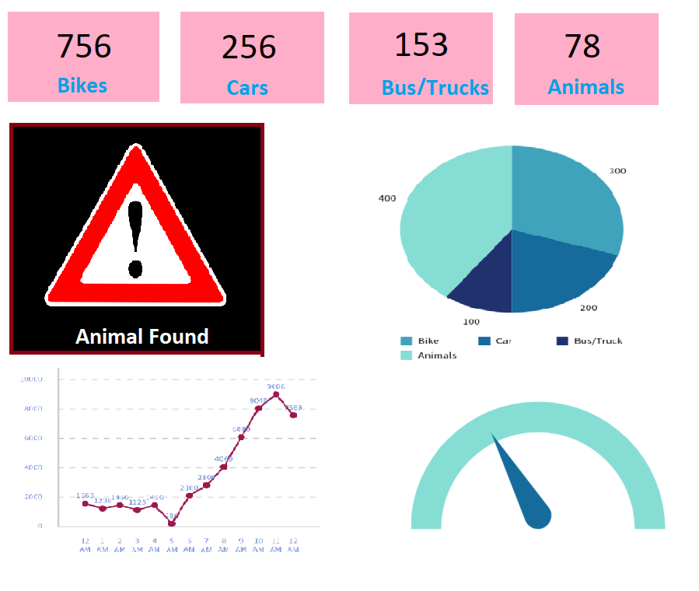
Sample
Dashboard…

Slide 6
Technology
Backend:
Python, OpenCV, YOLOv8.
SQLite/MySQL for data storage.
Frontend:
HTML, CSS, Java Script, Bootstrap
Flask for API and local web hosting.
Dashboard Framework: Streamlit, Dash, or Plotly, Power BI
Libraries:
NumPy, pandas, Matplotlib/Seaborn for data analysis.

Slide 7
Cont…
Others:
Google Colab for model testing.
Integration with real-time data sources
VS Code for development

Slide 8
Project Division
Object Detection Page :
Using this page we load the video
Object detection and classification is done here.
Have only access for higher authorities
Dashboard web page:
Can access by all
Data analysis and visualization will be projected here
All kinds of alerts will be projected here

Slide 9
KEY FUNCTIONALITIES
Object Detection:
YOLO v8 detects and classifies traffic objects.
Tracks objects crossing a designated line.
Data Storage:
Stores class counts with timestamps in a database.

Slide 10
Cont…
Dashboard Features:
Historical data visualization.
Real-time updates.
Generate reports for traffic analysis.
Animal alert update
Scalability:
Can integrate with live cameras.

Slide 11
RELEVANCE AND SCOPE
Traffic Management
Helps authorities plan better routes and signals.
Urban Planning:
Identifies congestion hotspots for infrastructure development.
Smart Cities:
Forms the backbone for automated traffic control systems.
Animal Alert
Giving alert if any animal found in the road.
Helps to avoid accident caused by animals

Slide 12
PAPERS
K. Guo, X. Li, M. Zhang, Q. Bao and M. Yang, "Real-Time Vehicle Object Detection Method Based on Multi-Scale Feature Fusion," in IEEE Access, vol. 9, pp. 115126-115134, 2021, doi: 10.1109/ACCESS.2021.3104849.
S. Phatangare, R. A. Sakpal, S. N. Kasurde, S. S. Punde and S. S. Khan, "Real-Time Traffic Management Using Deep Learning and Object Detection using YOLOv8," 2024 15th International Conference on Computing Communication and Networking Technologies (ICCCNT), Kamand, India, 2024
S. K. Saini and M. Singh Ghumman, "Automated Traffic Management System Using Deep Learning Based Object Detection," 2022 International Conference on Machine Learning and Cybernetics (ICMLC), Japan, 2022
J. D. C, S. S, S. Amaran, S. K. K and K. U, "YOLO-based Traffic Signal Optimization for Intelligent Traffic Flow Management," 2024 8th International Conference on I-SMAC (IoT in Social, Mobile, Analytics and Cloud) (I-SMAC), Kirtipur, Nepal, 2024
Y. M. Dalal, S. Naveen and A. K. UM, "Unveiling Traffic Patterns for Effective Traffic Management System," 2023 International Conference on Network, Multimedia and Information Technology (NMITCON), Bengaluru, India, 2023

